Slide 1
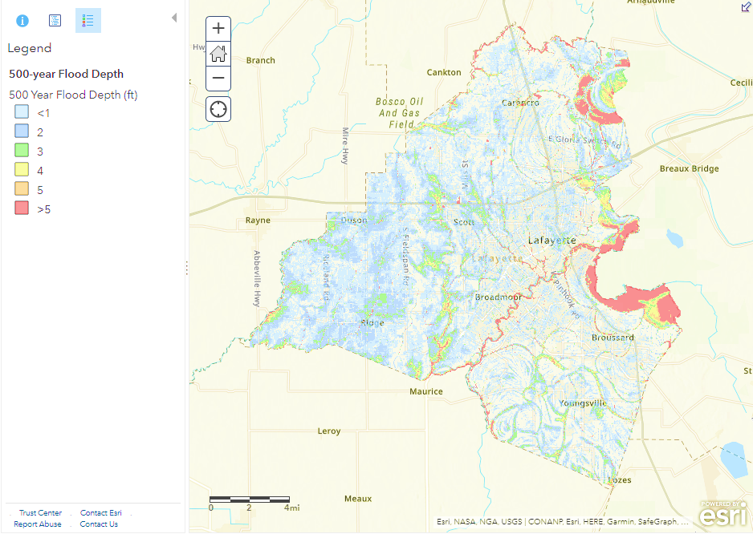
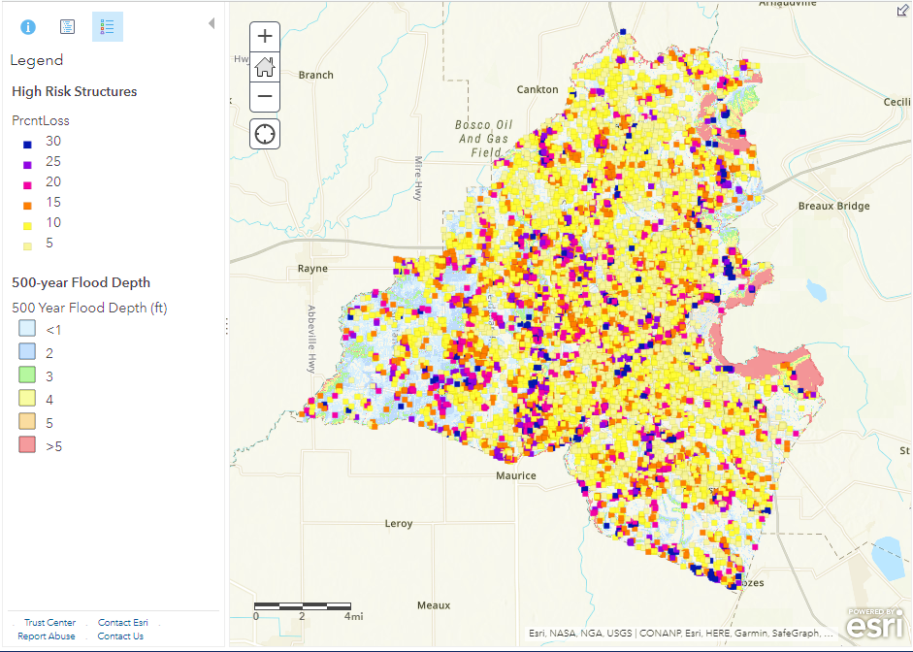
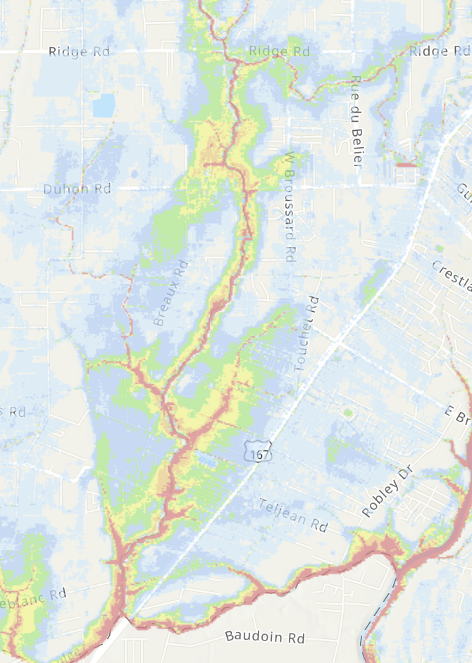
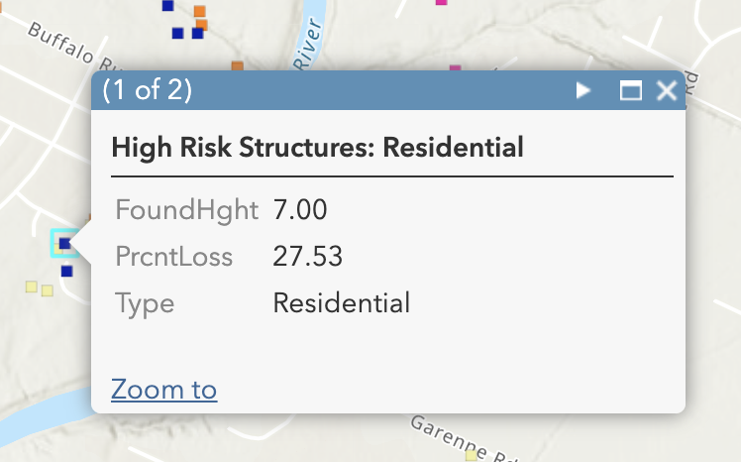
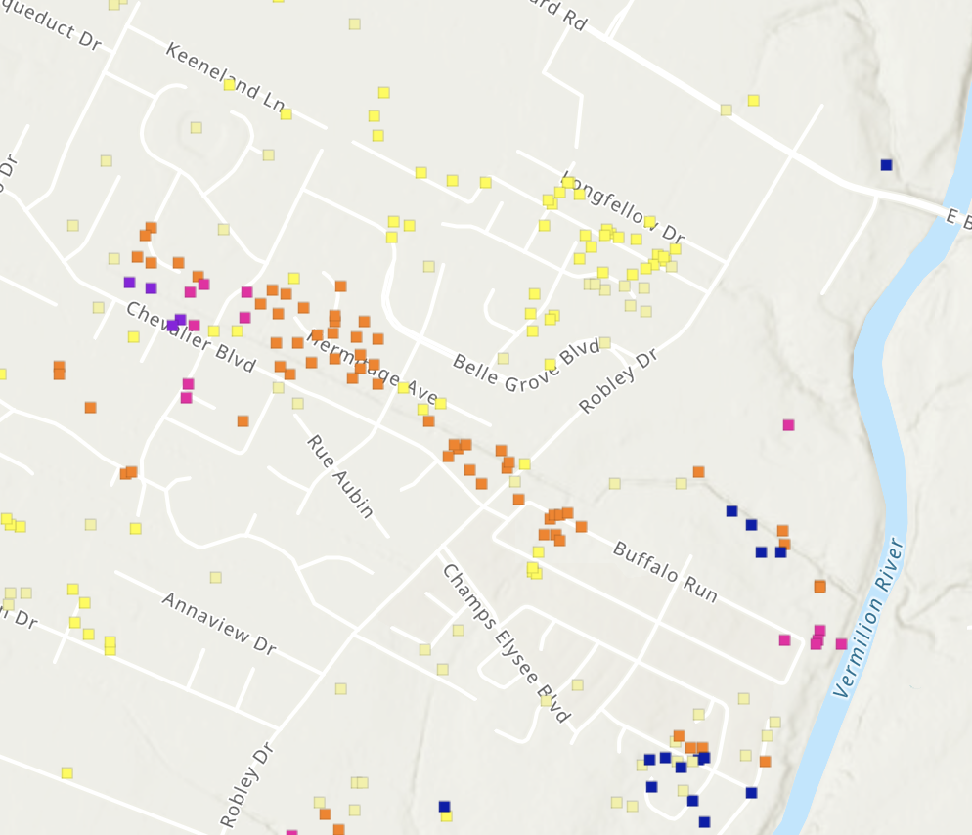
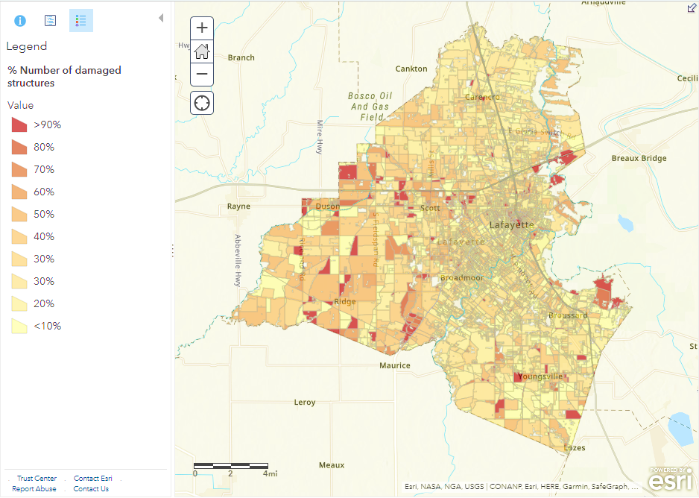
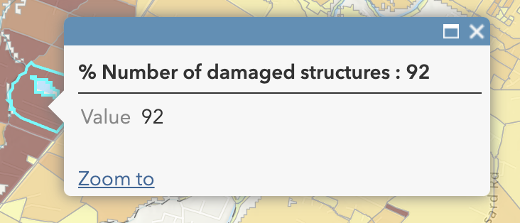
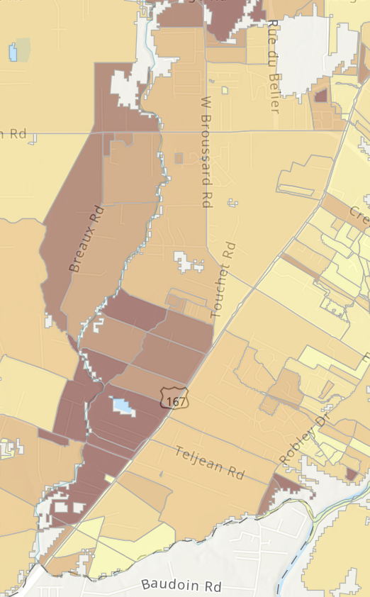
Title
Author 1, Author 2, Author 3, and Author 4
Department, School, University
Smart and Connected Communities:
Improving Community Engagement in Flood Mitigation Using Enhanced Risk Assessment Metrics and Science-Based Tools​
https://tinyurl.com/ullnsfscc2
Flood inundation and depth (500-year storm)
Structure damage for individual buildings
% loss in structure value
Structure damage aggregated to census block
In this app, you should be able to examine the following:
If a property is located within the 500-year inundation area and what the flood depth is at that location.​
Percentage damage at individual structures
Percentage of number of structures flooded in each census block.​
Percentage loss of structure value in each census block.​
Distinguish between losses in residential versus non-residential structures.​
% Number of damaged structures per census block
Award #: SCC-PG 2125472
Louisiana Watershed Flood Center | History, Geography, & Philosophy | Kathleen Babineaux Blanco Public Policy Center | Civil Engineering | Contact Information: Emad Habib (habib@louisiana.edu)
.
.
.
.
.
.

Slide 2
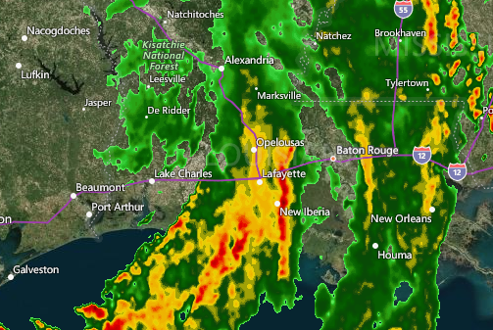
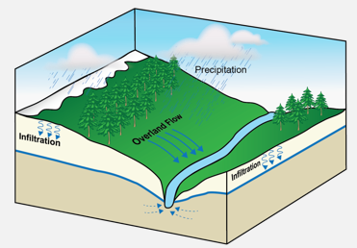
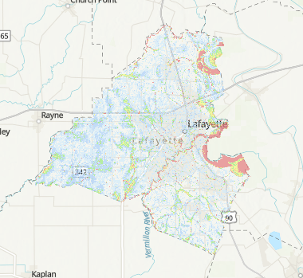
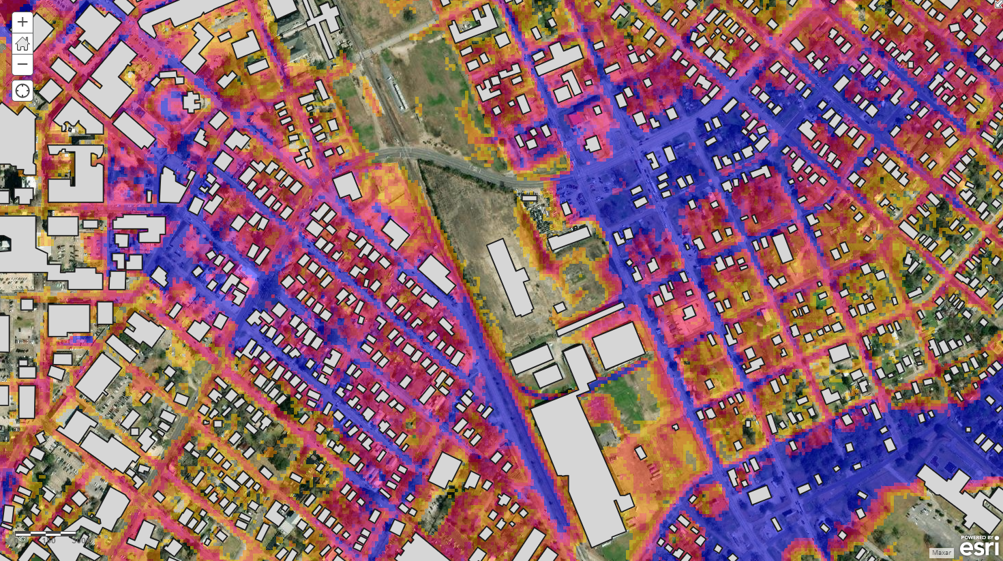
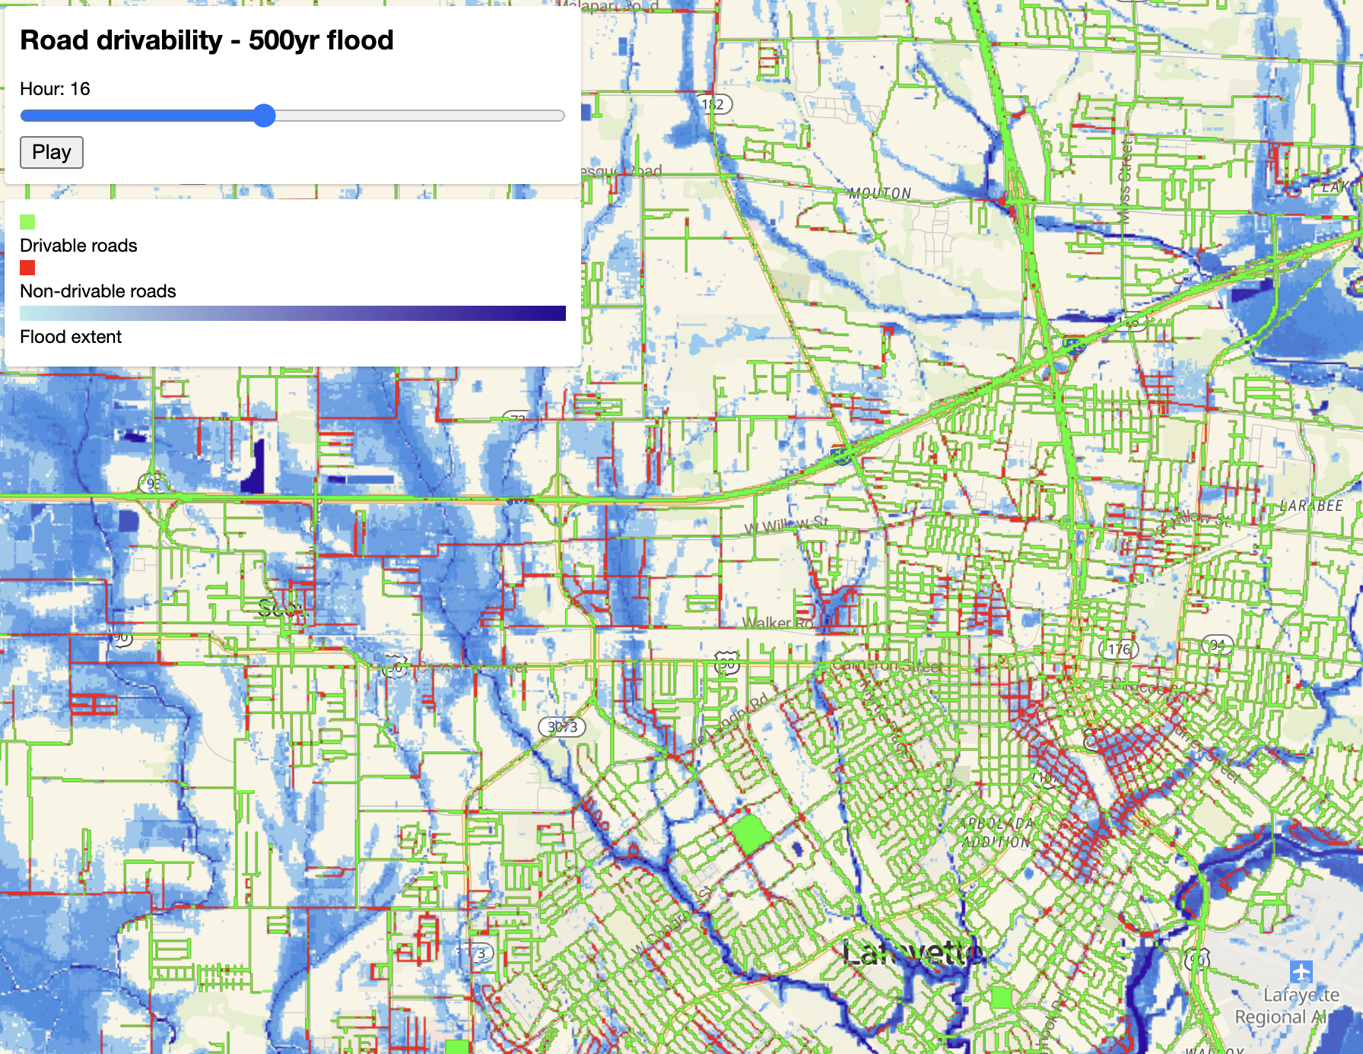
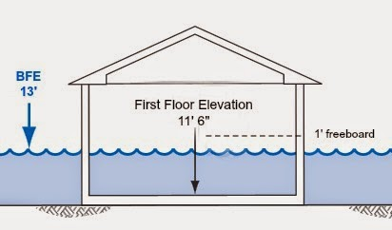
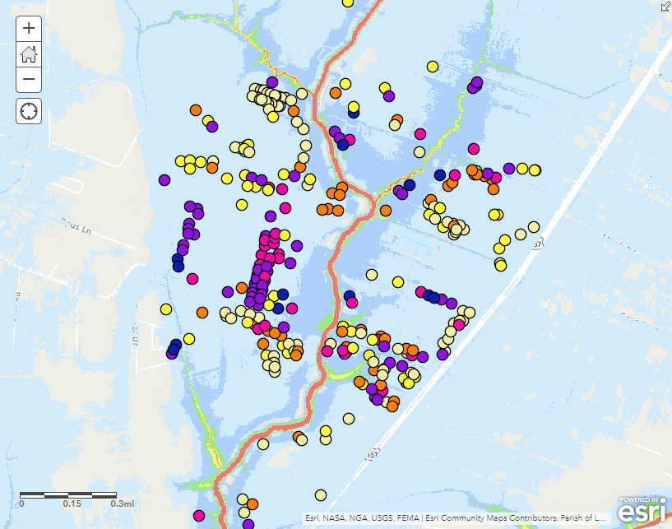
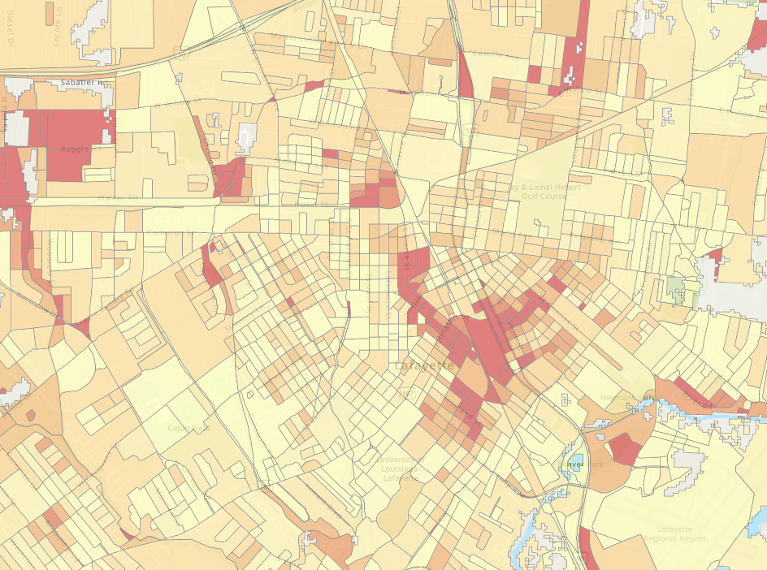
How did we develop these tools?
1) Develop 500-year storm based on NOAA Atlas
2) Run H&H models to estimate flows and flood depths
3) Generate 500-year flood map (extent, depth, duration)
4) Flood depth is intersected with buildings and roads
7) Examine impacts on drivability and access to emergency facilities evacuation routes
5) Calculate losses for individual structures
6) Display losses per building (left) or aggregated to census block level (right)

